Slide 1

Women in BAIS
Creating an Environment of Inclusion and Support
Kristine Arens
March 25, 2019
Notes:
Change ribbon – watch colors because they can confuse the viewer with what’s on the page.
Use storytelling with data principles on graphs. - Move labels to end of row, for example. Highlight what we want to show on graph.

Slide 2

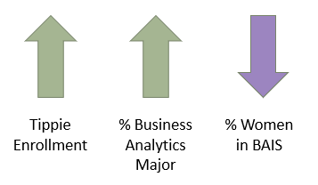
Purpose
Background
Over the past 5 years, the percentage of women majoring in Business Analytics and Information Systems (BAIS) at the TCOB has been steady, at around 40%. Recently, the total number of students majoring in BAIS is increasing, but the percentage of women is decreasing.
This project is focused on using TCOB data, Tippie female-focused student survey data, research, and external data to understand how to better support and encourage women to pursue a BAIS degree.
Why is gender diversity important?
Gender diversity brings a balance of cooperation and understanding between students.
Generally men and women approach problems differently. These different perspective bring growth in learning.
Companies recruiting TCOB graduates are interested in a diverse set of talent. More women could result in better recruiting at Iowa.
Focus
Approach
Findings
Understanding
Next Steps

Slide 3

Focus - Areas
Scope
Focus on women with undeclared major
High school through 2nd year UI student
Goal
Provide top 3 recommendations
Give guidance for State Farm Grant
Create guide for department innovations and differentiators
Current Business Direct Admission or Business Standard Admission status
Focus
Approach
Findings
Understanding
Next Steps

Slide 4

Approach
Evaluate TCOB Enrollment Data
Enrollment trends across the college
Survey Tippie Female Students
Discover how women perceive BAIS
Explore factors that influence their decisions
Understand why women choose BAIS
Recognize how women want to be supported
Research Women in STEM* and Factors of Influence
Social inclusion
Underrepresentation in STEM - focus on MIS, IS and Computer Science articles
Stereotyping
Gender bias
Major enrollment by gender
Direct Admit enrollment
Fall 2013 – Fall 2018 data
*Note: Minimal research found on women in analytics and information systems, therefore focus on Women in STEM and Computer Science articles.

Slide 5

FINDINGS
Create meaning from data and research

Slide 6
Tippie Women’s Survey – Response Rate
Number Surveyed
1465
Total Opened
1017
(69%)
Total Responses
369
% Response Rate*
36%
Survey sent via email
All undergraduate women with a tie to Tippie sent survey
Ran for 2 weeks from 1/22/19 – 2/1/19
Declared and Undeclared students identified
* % response rate calculated using total responses/total opened.

Slide 7
Tippie Women’s Survey - Who Responded?
57% Declared Major (210)
43% Undeclared Major (159)
21% Declared - BAIS (45)
27% Undeclared BAIS (43)
Response from BAIS Women 10% lower than TCOB BAIS enrollment
Interest in BAIS by undeclared slightly lower than TCOB BAIS enrollment
*Women may be counted more than once for each category based on multiple majors or multiple major interest areas

Slide 8
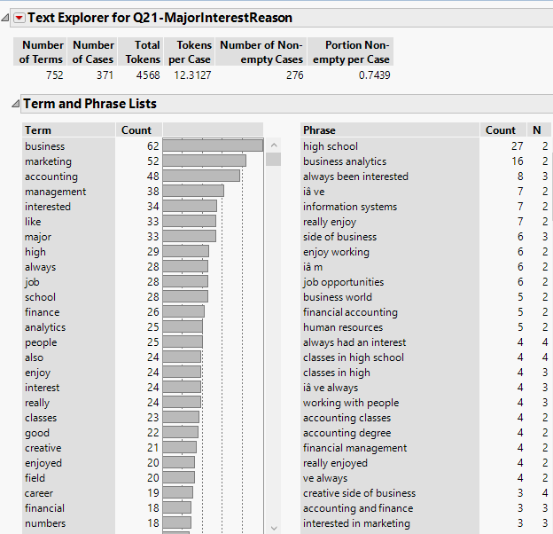
Reason for Interest in Major
High school courses significant influence
Exposure to jobs (family, high school work, or internships)
Previous exposure translate to interests

Slide 9
Tippie Women’s Survey - Results
44
Interested in Student Organization
41
Interested in Focus Group
56%
Want more info about the major in 1st and 2nd year
48%
BAIS Women want a mentorship program

Slide 10
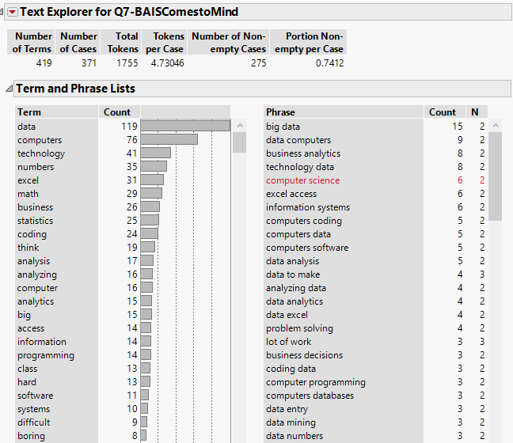
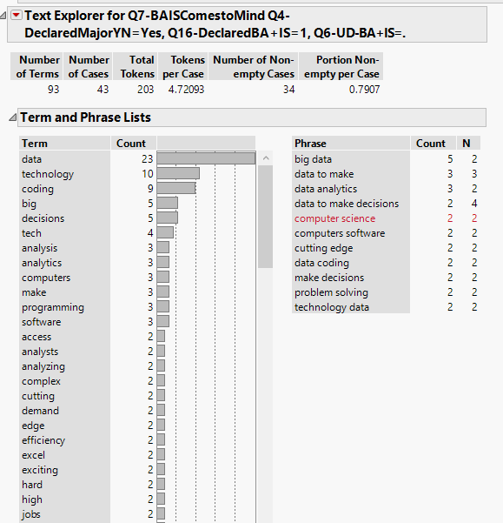
BAIS - What Comes to Mind?

Slide 11
Are Women Leaving?
NO
Only 3 female students left BAIS
1% of respondents (ncnt = 210 declared)
“I thought marketing sounded like a better fit for my personality.”
“Did not have time to graduate with degree due to lack of awareness for the degree -- the major was not heavily promoted until my Junior year.”
Focus
Approach
Findings
Understanding
Next Steps

Slide 12

UNDERSTANDING
Converting data into ideas

Slide 13
Understanding – 3 Focus Areas
Image
Community
Educational INFLUENCES

Slide 14

Image
“Providing students with a thorough understanding of the MIS major and the different career options that are available to MIS professionals, and helping them understand the differences between MIS and more technical IT fields would be influential in changing the barriers perceived by students.” (Akbulut, 2017)
“…participants expressed a yearning to contribute to the collective well being of society using their computing skills.” (Carrigan, 2017)
“…interdisciplinary studies advance the theory that social purpose is an important factor to consider in working toward gender equality…” (Carrigan, 2017)
Need more information
Greater good and\or social purpose
More than just technical perception
Focus
Approach
Findings
Understanding
Next Steps

Slide 15
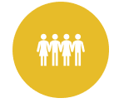
Community
“One of the most effective interventions to help young women choose and sustain a STEM educational path and subsequent STEM career is mentoring.” (NSF, 2007)
“College is when individual students' pathways begin to diverge. That's where belonging and confidence help determine whether someone will keep moving along a STEM pathway or move off that path onto a non-STEM path.” (Dasgupta, NSF 2016)
Need to feel comfortable and confident
Want collaborative support
Feel a sense of belonging
Involvement
Focus
Approach
Findings
Understanding
Next Steps

Slide 16

Educational Influences
“…women students who have had either one-on-one contact with…same-gender professors, experts or peers, feel ‘I belong here.’ This in turn makes them more confident in their abilities…” (Dasgupta, NSF 2016)
“Results from several lab and field studies revealed that exposure to female STEM professors and experts enhanced women’s positive implicit attitudes toward STEM, increased their identification with STEM, their confidence in STEM, and effort on tests and exams.” (Dasgupta)
High school class offerings
Authority figure attitudes
teacher, parent, advisor
Female faculty
Tippie female admissions
Focus
Approach
Findings
Understanding
Next Steps

Slide 17

NEXT STEPS
Translate findings into recommendations

Slide 18
Recommendations
Mentorship Program
BAIS Major Introduction
WiSE Recognition
Marketing the BAIS Program in High Schools
Faculty Bias
Intro Course Refinement

Slide 19
Top Recommendations
Create Peer Mentorship Program
Female-centric organization
Connect Junior and Seniors with Freshman and Sophomores
Volunteer program
One to many
Faculty advisor facilitated
Recognition by WiSE
Obtain BAIS STEM approval by Iowa’s WiSE program
Acknowledge and embrace STEM designation
Encourage engagement with campus programming
Introduce the BAIS Major
Create specialized marketing for BAIS major
Sell major at Tippie Direct Admit Seminar & Introduction classes
Encourage faculty to speak the refined language of “what is BAIS”
Create high school connections and market to target schools
Host a “Get to Know Us” event featuring women industry and major
Focus
Approach
Findings
Understanding
Next Steps

Slide 20
Full Recommendation Matrix
 | Recommendation | Influence Level | Effort | Term
1 | Women in BAIS Mentoring Program | Department | Medium | Short (Fall 2019)
2 | WiSE Recognition | University | Low | Short (Fall 2019)
3 | Faculty Bias Exploration (UG faculty focus) | Department | Medium | Short (Spring 2020)
4 | Refine Intro Courses (Info Sys and Bus Analytics) | Department | Medium | Mid-term (Fall 2020)
5 | Update Marketing (Add Focus on Social Purpose) | College (TCOB) | Medium | Mid-term (1-2 years)
6 | Interdisciplinary Options | College (TCOB) | Low | Mid-term (1-2 years)
7 | High School Marketing | College (TCOB) | Medium | Mid-term (2 years)
8 | Research Predictive Model Targeting HS Women | College (TCOB) | High | Long Term (2-4 years)
9 | Create Learning Teams (Equal Men\Women) | College (TCOB) | Medium | Mid-term (1-2 years)
10 | Faculty Balance (40% Women) | Department | High | Long Term (3-5 years)
11 | Create Tutoring Program for Women | College (TCOB) | High | Long term (2-4 years)

Slide 21
Appendix
Women in BAIS Additional Resources

Slide 22
Gender Bias Resources
Resources for gender bias training:
https://wiseli.wisc.edu/
MIT Teaching Systems, Unconscious bias in teaching
https://mit-teaching-systems-lab.github.io/unconscious-bias/
Harvard - Implicit Bias Test
https://implicit.harvard.edu
National Science Foundation (NSF) Girls in Science and Engineering Teaching Toolkit
https://www.nsf.gov/pubs/2006/nsf0659/nsf0659.pdf

Slide 23
Gender Bias Examples in STEM
Faculty call on men more than women.
Women tend to be more thoughtful in response, so when called on by faculty if they don’t answer quickly, faculty will move on and call on a male.
Unequal teams where men outnumber women cause women to be included less.
Men will interrupt women more often than other men.

Slide 24
References
Carrigan, CM (2017) Yearning to Give Back: Searching for Social Purpose in Computer Science and Engineering. Front. Pyschol. 8:1178. https://www.frontiersin.org/articles/10.3389/fpsyg.2017.01178/full
Buse K (2018) Editorial: Women’s Under-representation in Engineering and Computing: Fresh Perspectives on a Complex Problem. Front. Psychol. 9:595. https://www.frontiersin.org/articles/10.3389/fpsyg.2018.00595/full
Beyer, Sylvia. (2006). Gender differences in Computer Science and MIS majors. https://www.researchgate.net/publication/281321959_Gender_differences_in_Computer_Science_and_MIS_majors
Akbulut, Asli. (2017) Underrepresentation of Women in Management Information Systems: Gender Differences in Key Environmental Barriers. https://waset.org/publications/10007287/underrepresentation-of-women-in-management-information-systems-gender-differences-in-key-environmental-barriers
Dasgupta, Nilanjana, Professor, Department of Psychological and Brain Sciences, University of Massachusetts at Amhurst http://people.umass.edu/nd/index.html

Slide 25
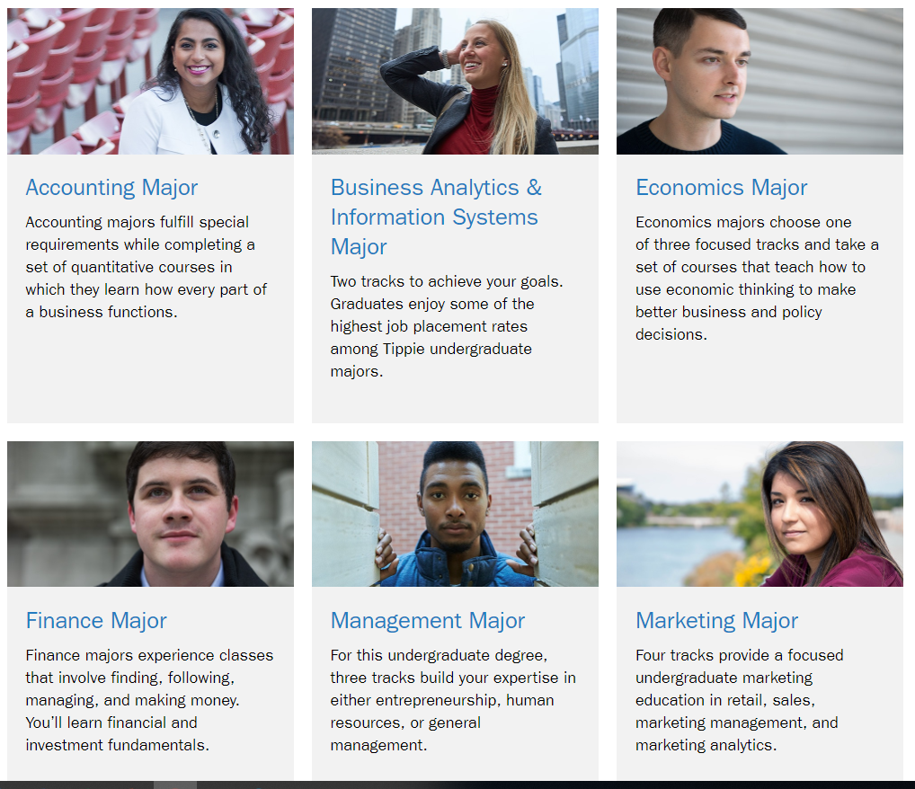
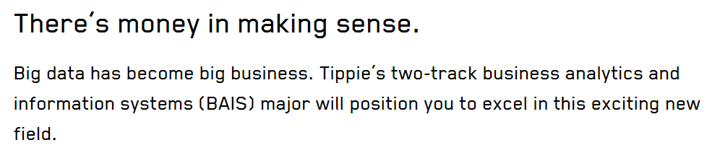
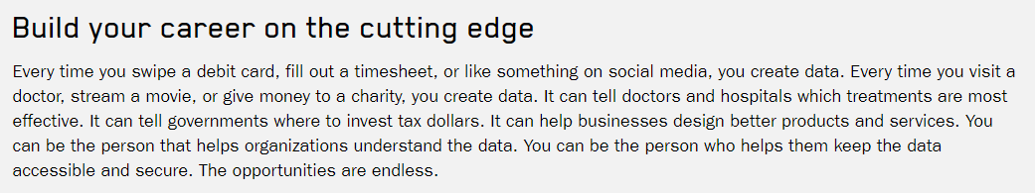
Image – What is this Major?
The message is “go into this major if you want to make a lot of money”.
Does this provide information students are looking for?
Is there a diverse implementation of analytics and information systems? Careers focused on a social purpose?

Slide 26
Article 2
“…participants expressed a yearning to contribute to the collective well being of society using their computing skills.” (Carrigan, 2017)
“…interdisciplinary studies advance the theory that social purpose is an important factor to consider in working toward gender equality…” (Carrigan, 2017)
“Computer Science and Engineering (CSE) has tendencies to devalue and delegitimize socially applied knowledge, ideas, beliefs, and practices that are grounded in communal, people-oriented values and can thwart the social aspirations of its practitioners.” (Carrigan, 2017)
“…CSE culture deems work with a social purpose to be irrelevant and outside the scope of an engineer’s duties.” (Carrigan, 2017)

Slide 27
Article 1
“…students’ math and science self-efficacy beliefs, as well as transfer-oriented interaction, were significant and positive predictors for [females] intent to transfer into STEM fields.” (Buse, 2018)
“…women are more likely to continue taking computer science courses when they felt challenged and skilled in their initial computer science classes.” (Buse, 2018)
“…female learners are more likely than their male colleagues to be influenced by strategic and arithmetic-operative competencies regarding their mental effort indicated that separate women’s courses may be an effective approach for increasing representation in engineering.” (Buse, 2018)
“By better integrating and publicly acknowledging communal opportunities, the stereotypic perceptions of these fields could gradually change, making computing and engineering more inclusive and welcoming to all.” (Buse, 2018)

Slide 28
Article 4
“…familiarizing students with the MIS major and careers is important. Compared to other more established business majors such as marketing, finance, and accounting, MIS is a relatively newer area of study and career option, which many students may be unaware of or may misunderstand.” (Akbulut, 2017)
“Providing students with a thorough understanding of the MIS major and the different career options that are available to MIS professionals and helping them understand the differences between MIS and more technical IT fields would be influential in changing the barriers perceived by students.” (Akbulut, 2017)

